Slide 1
Membrane Air Separation
Group #2
Ameen Abuzir, Joshua Laforest, Javier Silva, and Cesearo Dilosa
Chemical Engineering Lab I
10/14/2025

Slide 2
Purpose of Lab
The objective of the laboratory experiment was to determine the efficiency of membrane air separators and how it’s influenced by various pressures, flowrates, and alignments.
This lab also allows students to see how theory can be coupled with reality. Including the limits of both.

Slide 3

Technical Nature
Membrane air separation is a process that relies on gas permeation through a semi-permeable membrane
A compressed mixture of oxygen and nitrogen are sent into hollow fiber membranes and diffused based on their size and solubility
Oxygen, more soluble and smaller than the nitrogen, permeates more rapidly, resulting in an oxygen permeate stream and a nitrogen residue stream
The process is based on Fick’s Law of Diffusion $J=\frac{P}{l}(p_{1}−p_{2})$, which operates on the basis that the rate of the gas transfer is proportional to the concentration of the gradient across the membrane
J = gas flux
P = permeability of the coefficient of the membrane
l = membrane thickness
$p_{1}$= partial pressure of gas
$p_{2}$ = partial pressure of feed
The separation efficiency is then dependent on the feed pressure, membrane surface area, and the selectivity of the membrane material
To solve for the transfer coefficient, the equation is altered and manipulated to $K_{j}= \frac{g_{j}}{(p_{j,t}−p_{j,s})}$
$$K_{j} \text{= }\text{transport} \text{coefficient}$$
$$g_{j} \text{= }\text{molar} \text{flow} \text{rate} \text{of} \text{the} \text{gas} \text{through} \text{the} \text{membrane}$$
$$p_{j,t} \text{= }\text{average} \text{partial} \text{pressure} \text{of} \text{gas} \text{on} \text{the} \text{tube} \text{side}$$
$$p_{j,s} \text{= }\text{average} \text{partial} \text{pressure} \text{of} \text{gas} \text{on} \text{the} \text{shell} \text{side}$$

Slide 4
Theory
This lab operates with nonporous semi-permeable tube-like membranes that are bundled together and put into a shell. There are O2 sensors at the combined outlets of the membranes, as well as the shell. For the experiment, air (21% O2; 79% N2) is sent through the membranes and based on the individual permeabilities, diffusivities, and solubilities of the molecules, also the membrane selectivity, the outer shell and the membranes themselves will have different concentrations and molar flowrates of O2 & N2.
These concentrations vary further when the operating pressure (inside the membranes) changes. Also, the molar flowrates. The idea is that increasing pressure, which causes a greater ΔP in the lumen of the membrane, and decreasing flowrate, to give a higher residence time, will give a greater O2 concentration shell-side and a greater N2 concentration tube-side. This is because O2 is naturally more permeable and these parameters only increase its capabilities.
The two main equations used in this lab are Fick's law (diffusion) & Henry's law (solubility).

Slide 5
Apparatus
EQUIPMENT | DESCRIPTION
Regulating Valve and Gauge | Limits gas flow to 200 psig
Oxygen Concentration Reader | Device connected to end of membrane to read the amount of oxygen present at the end of the separation cycle.
Four 3-way Valves | These four valves allow the system to be run in parallel or in series.
Needle Valve | Can be manipulated to control the flow rate of tube-side effluent.
Air Flow Reader | Measures the flow rate of gas traveling tube-side and shell-side.
High-Pressure Air Cylinder | Stores the air that will be used in the experiment
Pressure Transducer | Reads the amount of pressure going into the system.
Membrane | Where air septation is taking place, can have two running in a series or 2 at the same time for parallel.

Slide 6
Material and Supplies
MATERIALS & SUPPLIES | DESCRIPTION
Ultra Zero Compressed Air | This is pressurized purified air, that mainly consists of N2 and O2, that will flow through the system and allow for a precise experiment with good data.
Power Strip | Supply power to equipment; also contains a ground fault circuit interrupter (GFCI) to protect against dangerous shocks. Also contains a 15-ampere overload protector.
Hollow Polymeric Fibers | These fibers act as non-porous semipermeable membranes that allow N2 and O2 to permeate and exit tube-side to enter the shell-side.

Slide 7
Procedure
Activate the readers in the system by turning on the electricity.
Open the gas cylinder valve, open the pin needle valve to adjust the amount of pressure going into valve and manipulate the final valve to adjust the flow rate into the system.
Once desired flow rate and pressure are reached run for 10 minutes to reach steady state.
Align the valves to desired configuration. Parallel: Valve A (Left), Valve B (Down to vent), Valve C (Down), Valve D (Up). Series: Valve A (Right), Valve B (Up), Valve C (Up), Valve D (Up).
Run the system until steady state and repeat at different pressures ranging from 20 psia to 100 psia. And at different flow rates.
Redo the experiment in series and parallel.

Slide 8
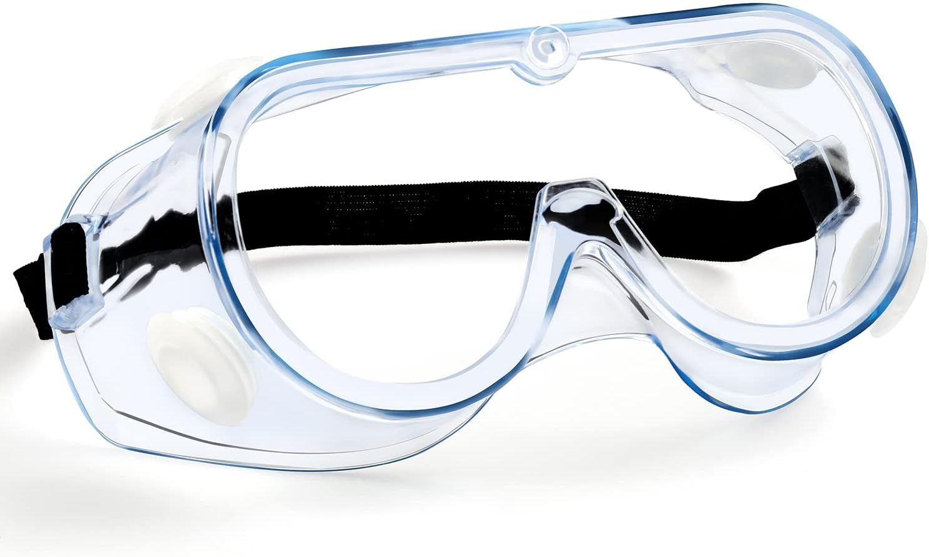
Safety
Wear safety goggles due to the possible over-pressurization of the system. Also because of the unexpected nature of the laboratory.
Make sure air cylinder is properly pressurized and well grounded.
Do not have all the three valves facing in the middle or else this will damage the system.
Be aware of the power cord. Ensure no wires are exposed during the experiment.

Slide 9
Experimental Challenges/Lessons Learned
There are many calculations in the analysis. Start early and understand what you're calculating so you can set your excel sheet up for efficiency.
Be aware of pressure drops when switching the membrane configuration from series to parallel. Be ready to adjust valves accordingly.
When operating in series make sure to measure O2 levels and flowrates individually for each ASU by manipulating valves.
Have a good understanding of theory and the equations involved. This will help with error analysis.

